Slide 1
Bugs Tracking System

Slide 2
Abstract
For many years, bug-tracking mechanism is employed only in some of the large software development houses. Most of the others never bothered with bug tracking at all, and instead simply relied on shared lists and email to monitor the status of defects. This procedure is error-prone and tends to cause those bugs judged least significant by developers to be dropped or ignored. Bug Tracking System is an ideal solution to track the bugs of a product, solution or an application. Bug Tracking System allows individual or groups of developers to keep track of outstanding bugs in their product effectively. This can also be called as Defect Tracking System.

Slide 3
PROJECT DESCRIPTION
1) Project Details:
This module has contained the master information about projects. Each one has unique project ID for identifying project Name, Contract Date, Contract years, platform details and so on. Project is organized into several categories.This can be maintained by QA who is the controller of all projects.He maintains the project status up to date.

Slide 4
2) Admin:
QA is the Admin of this application. The Roles of the QA is
1)Add new projects to the system.
2)Post new bugs to the system
3)Delete existing bugs from the system.
4)Upload snapshots of errors in the system.
5)Sends bug list to developers those who are involved in this project.
6)Receives the solutions for bugs which are sent by the developer.
7)Verifies the solutions corresponding to that problems.

Slide 5
3) Developer:
Developer can only view the Bug List and can update the status of Bug as Pending, Completed .in progress or Bot and Bug etc as provided by the QA. Developers can share the information about Bugs with other Developers. They have the provision of sending mails and receiving mails about the Bugs.

Slide 6
4) Bugs:
In this Module, the bugs are generated for projects with the details of project name, description, modules in which bugs are raised and description about the bugs.

Slide 7
5) Reports:
Reports are generated as per the requirements. QA generates Bug list those which are solved or not yet solved. QA can watch how many developers visited the bug list.

Slide 8
HARDWARE SPECIFICATION
Processor : Core I-3
Processor Speed : 2.5 Ghz
Ram : 2 GB
Hard Disk Drive : 500GB

Slide 9
SOFTWARE SPECIFICATION
Operating System : Windows 7
Technology Used : PHP
Database : My-Sql
Database Connectivity : Native Connectivity
Web Server : Apache
Browser : Internet Explorer 6.0

Slide 10
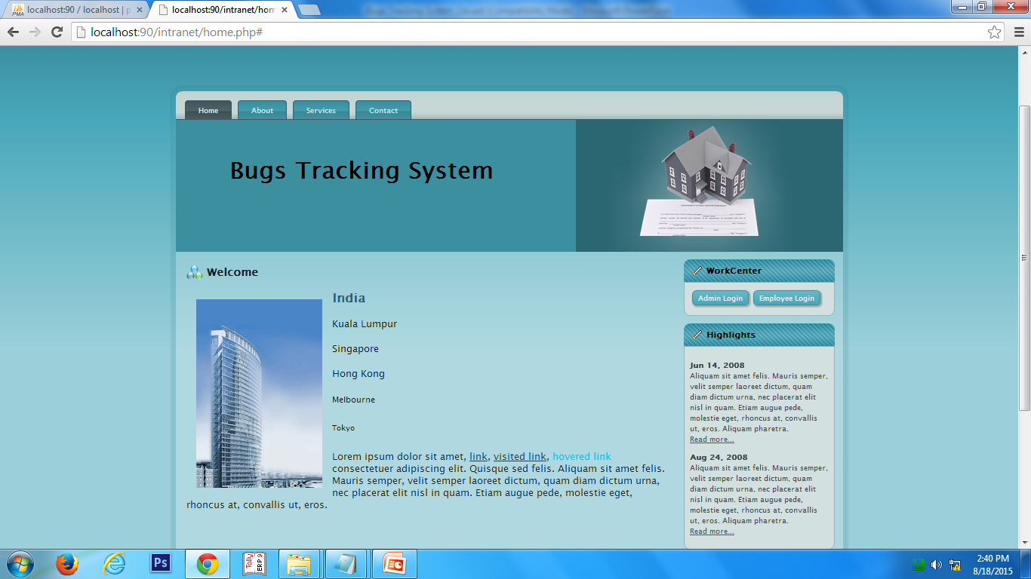

Slide 11
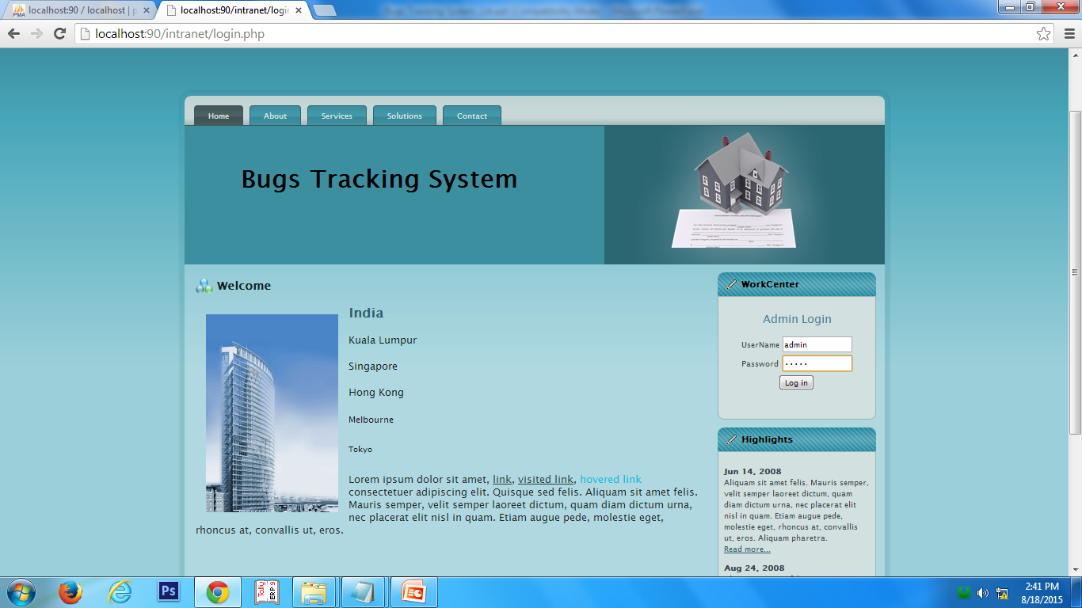

Slide 12
